Slide 1
Structures for Discrete-Time Systems
Ajit Bopardikar
Conexant India Ltd
Hyderabad
India

Slide 2
Introduction
Variety of computational structures result in the same relation between input sequence and output sequence
Different structures may have distinctly different behavior when numerical precision and computational complexity are concerned

Slide 3









Building Blocks
Adders
Multipliers
Unit Delay

Slide 4
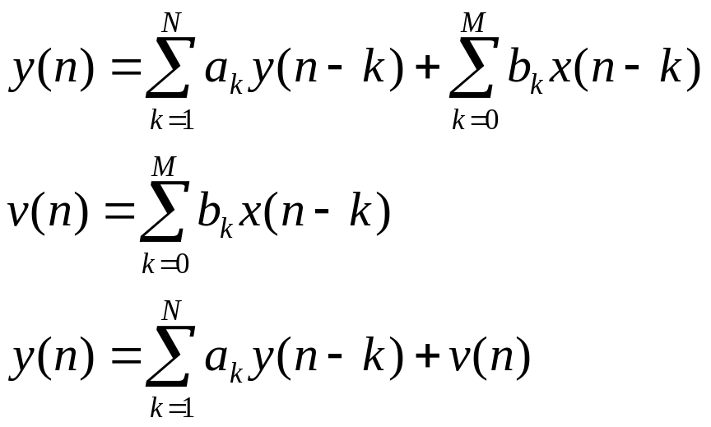
Difference Equation Implementation

Slide 5
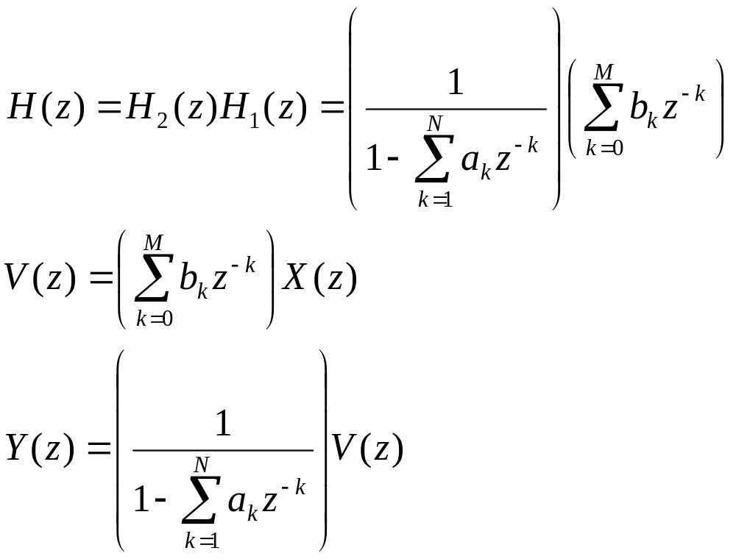
z-Transform Interpretation

Slide 6










Difference Equation Implementation: Direct Form I

Slide 7
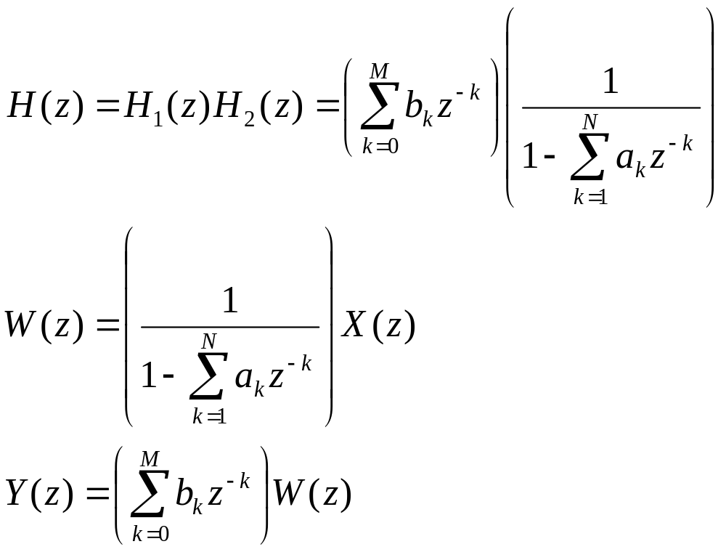
z-Transform Interpretation
Interchanging the two filters

Slide 8

Another Implementation: Direct Form II

Slide 9
Features Of The Two Implementations
1st Implementation: Zeros implemented before poles
2nd Implementation: Poles implemented before zeros
Order of implementation does not affect the overall system function, theoretically (finite wordlength effects not considered)‏
Total delay elements (N+M) the same in both case.
In 2nd Implementation, the delay chains can be combined into a single delay chain of length max(N,M).

Slide 10


Cannonic Form
Implementation with minimum number of delay elements

Slide 11
Practical Considerations in Choosing a Structure
Computational Complexity: fewest constant multipliers and fewest delays (memory register) branches is most desirable
Multiplications are costly in digital hardware
Fewer delay elements means reduced memory requirement

Slide 12
Practical Considerations in Choosing a Structure
Modularity and simplicity of data transfer on the chip
Finite register length and finite precision arithmetic

Slide 13




Signal Flow Graph Representation
Network of directed branches that connect at nodes
Each branch has an input signal and an output signal
Branch originating from node j and ending at node k is denoted by (j, k)‏
Value/Sequence associated with node k:
For the linear case, the output of a branch is a linear transformation of the input
Examples of linear transformations: Gain, delay; represented next to the branch; if no representation: identity transformation
node k
node j

Slide 14
Signal Flow Graph Representation
Source nodes: No entering branches: Represent injection of external inputs
Sink Nodes: Have only entering branches: outputs from the flow graph

Slide 15
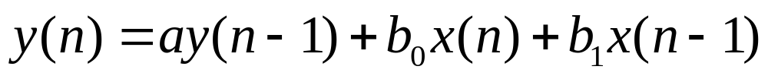
Signal Flow Graph: Example

Slide 16
Signal Flow Graph Features
Branching point in a block diagram is a node with one incoming branch and one or more outgoing branches
An adder in the block diagram is a node with two or more incoming branches and one outgoing branch

Slide 17
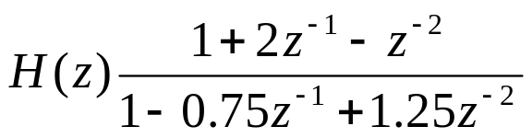




Examples: Type I and Type II Implementations
Type I
Type II

Slide 18
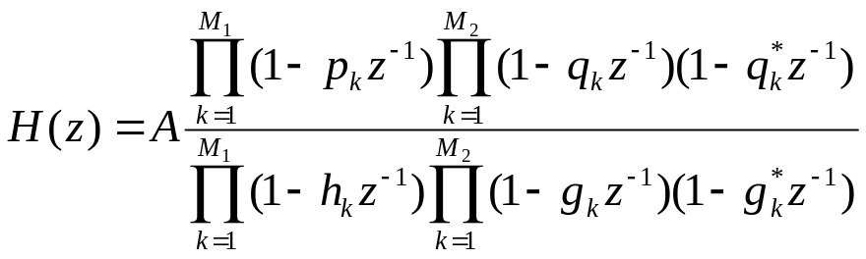
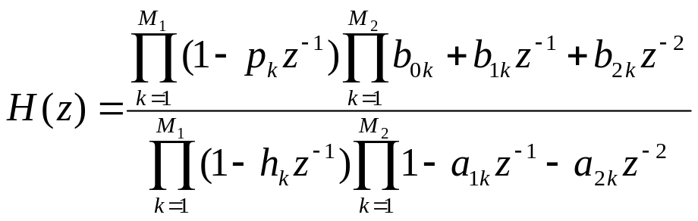

Cascade Form
Factor the numerator and denominator polynomials
Can be seen as a cascade of systems with one or two poles and zeros
We assume

Slide 19
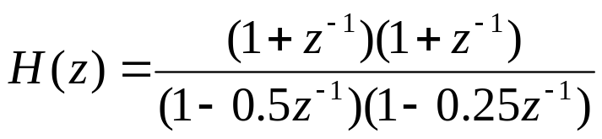


Cascade Form: Example
Type I
Type II

Slide 20
Cascade Form: Features
Cascade of first and second order systems
Considerable freedom of choice in composing the subsystems and the order in which they are cascaded
To modularize the practical implementation one can combine a pair of zeros to form second order factors

Slide 21
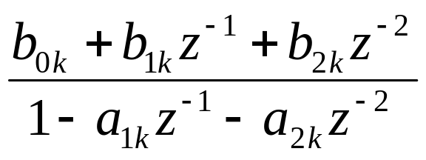
Cascade Form: Complexity
Suppose M=N.
Direct Form II: Number of Multipliers 2N+1
Factoring into second order factors, one obtains N/2 cascade factors of the form
5 multiplications per factor giving a total complexity of 5N/2

Slide 22
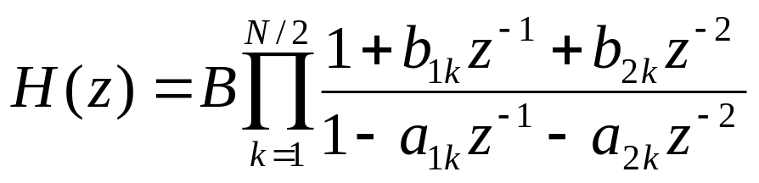
Cascade Form: Complexity
Rewriting the factors as
each factor has 2N multiplications. Total multiplications 2N+1
Same as Direct Form II

Slide 23
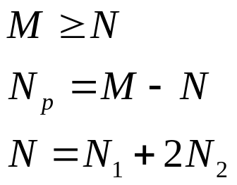
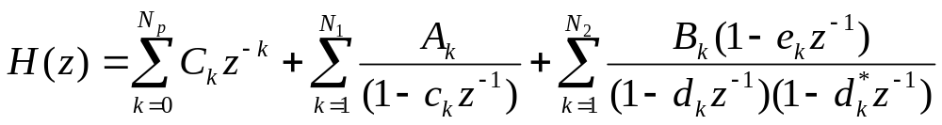
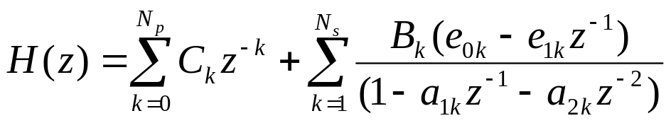

Parallel Form
Express the rational system as a partial fraction expansion
Can be rewritten by combining real poles as

Slide 24
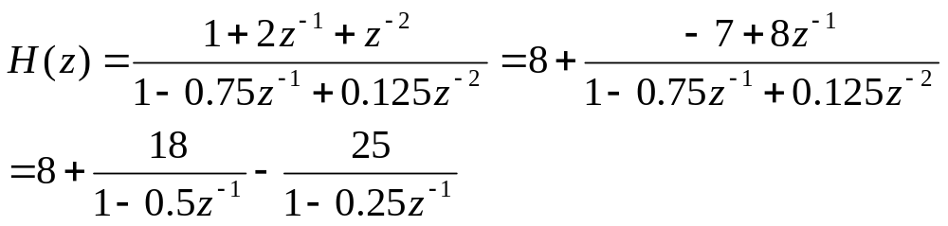
Parallel Form: Example

Slide 25



Parallel Form: Structure

Slide 26


Parallel Form: Structure

Slide 27
Transposed Form
Reverse directions of all branches in a network, leaving branch gains (transmittances) unaltered
Reverse roles of input and output so that source nodes become sink nodes and vice versa

Slide 28
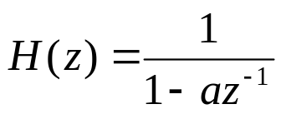
Transposed Form: Example

Slide 29


Transposed Form
Type II
Type II Transposed Form

Slide 30
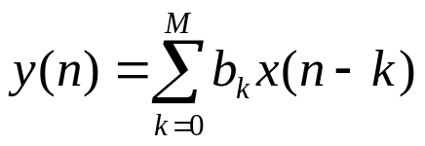


Structures For FIR Systems
Transposed Form
You can also obtain a cascade form by factorizing the z-transform

Slide 31
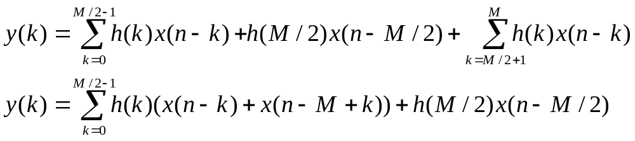
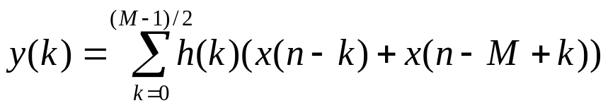
Structures for Linear Phase FIR Systems
Type I (WSS)‏
Type II (HSS)‏

Slide 32
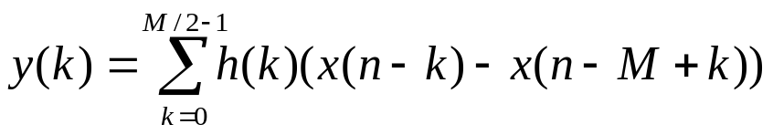
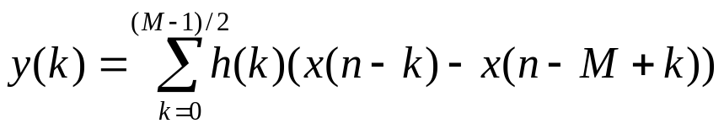
Structures for Linear Phase FIR Systems
Type III
Type IV

Slide 33
Reading List
Oppenheim, A. V., Schafer, R. W., “Discrete-time Signal Processing,” Prentice-Hall, India, 1989.

Slide 34


